Slide 1
Investment Companies

Slide 2
Services of Investment Companies
Administration & record keeping
Tax purposes
Low cost reinvestment
Low cost additional investment
Low cost switching between fund families
Some funds may allow check writing privileges
Notes:
Immediate advantages
Administer and keep track of all of your investments in one location. Keeps track of all of your distributions both capital gains and dividends. Will allow you to easily reinvest any distributions
Allows for easy diversification. Difficult for small investors to do when buying securities on there own. Allows small investor to hold a fraction of a share in a company.
Knowledgeable management of your portfolio. These managers generally have an MBA and plenty of experience trading securities.
Economies of scale allow for reduced transaction costs.

Slide 3
Services of Investment Companies
Diversification
Professional management
Reduced transaction costs
Investing for retirement: Most funds can be set up as an IRA (Individual Retirement Account)
Low cost, instant diversification
Lower research costs
Portfolio managed according to specific objectives
Professionals to find undervalued securities and/or engage in asset allocation strategies
Notes:
Immediate advantages
Administer and keep track of all of your investments in one location. Keeps track of all of your distributions both capital gains and dividends. Will allow you to easily reinvest any distributions
Allows for easy diversification. Difficult for small investors to do when buying securities on there own. Allows small investor to hold a fraction of a share in a company.
Knowledgeable management of your portfolio. These managers generally have an MBA and plenty of experience trading securities.
Economies of scale allow for reduced transaction costs.

Slide 4
Types of Investment Companies

Slide 5
Organizational Forms
Managed Investment Companies: Managed, usually changing composition portfolio.
___________________________________
The fund's board of directors typically hires an investment advisor to select and manage the fund assets according to some specific goal(s) set by the board and any regulatory requirements.
The investment advisor usually creates the fund and selects the investments. Most funds are of this type.
More commonly known as a ‘mutual fund’
Notes:
Soros funds – give money to other investors

Slide 6
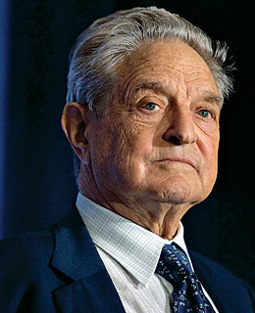
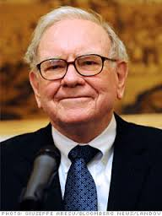
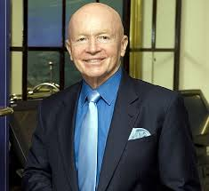
Georgy Soros Warren Buffett Mark Mobius
Soros Fund Berkshire Hathaway Templeton Fund

Slide 7
Organizational Forms
A managed investment company (mutual fund) may be
Open end
Fund issues new shares when investors buy in and redeems shares when investors cash out
Priced at Net Asset Value (NAV)
Closed end
No change in shares outstanding; old investors cash out by selling to new investors in the marketplace (NASDAQ or an exchange) and the fund itself is not involved.
Priced at premium or discount to NAV
Notes:
Bizotsan van likviditás ha fizetőképes az alap

Slide 8
Differences in Open & Closed End
Most funds are open end:
The advantage of the open end form is
The disadvantage of the open end form is
Liquidity for the investor
Fund’s ability to grow (advantage for the fund or sponsor)
The need to keep a cash reserve
Vulnerable to panics
Notes:
About 90% of investment company assets are held in mutual funds.
For various reasons, actively managed mutual funds don't invest all the money at their disposal, but instead maintain cash balances of approximately 8%. Source: The Fool

Slide 9
Other Investment Org
Commingled funds
Partnerships of investors that pool their funds. Operates similar to a mutual fund.
REITs
Similar to closed end fund. Invest in real estate and real estate loans.
Hedge Funds
Can pursue investment strategies that are not allowed for mutual funds.
Notes:
Unit Trust- Fixed portfolio for the life of the fund, “unmanaged” portfolios. Managed Investment Company: A management team manages a portfolio for a fee.Open-End: This is the typical mutual fund an investor will buy. Here the fund issues or redeems shares at net asset value (NAV) For this reason cannot trade during day. Put in order during day. At end of day buy or sell at NAV price. Closed End funds trade like stocks on an exchange. Price can differ from NAV. Some trade at a premium and many trade at a discount. See p. 102
Commingled Funds: Similar to mutual fund. Designed for trusts or large retirement accounts to get professional management for a fee.
Real Estate Investment Trusts: Similar to closed end fund. Invest in real estate and real estate loans. Equity trusts in real estate. Mortgage trusts in mortgage and construction loans
Hedge Fund: Similar to Mutual Funds, but not registered and not subject to SEC regs. Rich investors. Can pursue investment strategies that are not allowed for mutual funds.

Slide 10
Mutual Funds

Slide 11
Net Asset Value
Used as a basis for valuation of investment company shares
Selling new shares
Redeeming existing shares
Calculation
Notes:
At the end of each day a NAV is calculated for the fund. In mutual funds this is the value used to buy or sell your shares.

Slide 12
Open-End vs. Closed-End Funds
Shares Outstanding
Closed-end: no change unless new stock is offered
Open-end: changes when new shares are sold or old shares are redeemed
Pricing
Open-end: Fund share price = Net Asset Value (NAV)
Closed-end: Fund share price may trade at a premium or discount to NAV
Notes:
Since closed end is like stock cannot redeem, must sell to another investor. Can only increase shares outstanding by having a new issue of more shares.

Slide 13
NAV calculation
ABC Fund ($Millions except NAV)
Market Value Securities
+ Cash & Receivables
- Current Liabilities
NAV Total
÷ # Fund Shares
NAV
Most Mutual Funds have little or no Long Term Debt
$550.00
75.00
(20.00)
$605.00
20.00
$ 30.25
Notes:
Investment company act of 1940 limits ability of mutual funds (MF) to employ leverage without tax disadvantage.

Slide 14
How Funds Are Sold
You find them
May avoid front end load
Front end load is an up front cost (fee) to purchase a share of a mutual fund.
Recommended by a broker or planner
Usually will have a front end load
May be revenue sharing on sales force distributed
Potential conflict of interest
Directly marketed
Sales force distributed
Notes:
About ½ of funds are directly marketed.
Revenue sharing: Fund company pays the broker for preferential treatment when making investment recommendations.

Slide 15
Investment Objectives
Index Funds
Broad market
Industry or market sector
International market
Size subset
Investment characteristics
Goal is to duplicate the performance of an index or market sector.
Low turnover, low expenses
Compatible Investor Goals
Investors who believe in ‘efficient markets’ and are seeking market returns with minimal expenses and turnover.
Stock funds still require ability to handle risk and staying power.

Slide 16
Investment Objectives
World, moderate, conservative
Convertibles
Near term (to 2014), Intermediate (2015-2029), Long term (2030+)
Investment characteristics
Hold both stocks and bonds, allocations may vary over time
Turnover varies
Higher income, lower capital gains & lower potential for capital loss
Compatible Investor Goals
Intermediate to long time horizon
Willing to face higher tax liability
Some ability to handle losses
Balanced funds
Allocation Funds
Target Date Funds

Slide 17
Funds & Investment Objectives
Investment characteristics
Focus on income and current yield
Lower potential for capital loss, inflation risk higher
Short, Intermediate, Long
Inflation Protected
Ultrashort, Short, Intermediate, Long
High Yield, Multisector
Emerging Markets, World
Bank Loans
Compatible Investor Goals
Short to moderate time horizon okay
Understand tax liability
Adds diversification, income and safety
Fixed Income funds
Federal Government
Corporate

Slide 18
Investment Objectives
Investment characteristics
Risk varies, but can be high, FX exposure
Expense ratios can be high
Substantial potential for capital loss
Size and Value/Growth
Size and Value/Growth
Compatible Investor Goals
Longer time horizon
Investor seeking diversification and/or higher returns
Ability to remain in the markets & handle losses
International Stock Funds
Foreign
Global or World
Geographic region
Emerging markets

Slide 19
Investment Objectives
Investment characteristics
Focus on safety of principal and income
Earn more than on bank accounts with little additional risk
Money market funds
Taxable
Tax Exempt
Compatible Investor Goals
Short time horizon
Add stability to a portfolio
Potentially large opportunity losses & inflation risk
Notes:
MMMF: NAV is fixed at $1, so no cg or cl, just income distirbutions.

Slide 20
Costs of Investing in Mutual Funds
Fee Structure
Operating expenses
12 b-1 charges
Front-end load
Back-end load (contingent), (redemption fee)
Buying and selling commissions, administrative expenses and advisory fees for the managers
Marketing costs paid by the fundholders
Alternative to a load, but assessed annually
Maximum is 1% of assets
Notes:
12b-1 max used to be 1.25%. Actually now 0.75%, but you can have a service fee of 0.25%.
In mutual fund quotes, r = redemption fee, p means there is a 12b-1 fee and T means there are both. Quotes do not identify front end loads.
Front-End. A commission or sales charge paid when you buy into a fund. Generally given to the broker who sells the fund. Rip-off
Back-End. Redemption or exit fee. These may be more useful since there are costs to all investors when investors cash out of the fund.
Operating expenses- Buying and selling commissions, Administrative Expenses and advisory fees for the managers.
12 b-1 Annual fees to pay for marketing and distribution costs.
Fact is that these fees can have a huge effect on your annual returns. High fees generally lower returns.

Slide 21
Hedge Funds: Definition
Today, funds using the “hedge fund” appellation follow all kinds of strategies and cannot be considered a homogeneous asset class.
Hedge funds can be defined as:
Funds that seek absolute returns
Having a legal structure that avoids some government regulations
Have option-like fees, including a base management fee and an incentive fee proportional to realized profits.

Slide 22
Hedge funds
Hedge fund managers can create leverage in trading by:
Borrowing external funds to invest more or sell short more than the equity capital that they put in.
Borrowing through a brokerage margin account
Use of financial instruments and derivatives.

Slide 23
Hedge Funds Characteristics
Hedge funds are:
typically open only to wealthy or institutional investors,
are commonly structured as private partnerships,
are only subject to minimal SEC regulation,
and can pursue strategies not available to mutual funds, such as short selling, heavy use of derivatives, and leverage.

Slide 24
Hedge Funds vs Mutual Funds
Transparency
Investors
Strategies
Mutual Funds Hedge Funds
Public info on portfolio composition
Unlimited
Must adhere to prospectus, limited short selling & leverage, limited derivatives usage
Info provided only to investors
< 100, high dollar minimums
No limitations
Notes:
Mutual funds are regulated under the SEC Act 1933 and the Investment Company Act of 1940 and they must invest according to the stated goals in the prospectus. They are to avoid ‘style drift.’
Some mutual funds can engage in short selling, but not to the extent that hedge funds can.
Hedge funds are not open to the general public. The primary investors are institutional investors but they are open to high net worth individuals. Most require minimum investments of $250,000, some go up to $1,000,000. A few now have a minimum investment of $25,000, but we will have to wait and see what kind of shakeout we have after the financial crisis.

Slide 25
Hedge Funds vs Mutual Funds
Mutual Funds Hedge Funds
Liquidity
Fees
Redeem shares on demand
Fixed percentage of assets; typically 0.5% to 2%
Multiple year lock up periods typical
Fixed percentage of assets; typically 1% to 2% plus incentive fee = 20% of gains above threshold return
Notes:
Liquidity: Note the lock up allows the funds to invest in less liquid assets and to avoid having to hold a cash reserve.
Fees: The threshold rate is pretty low, perhaps a LIBOR rate.

Slide 26
Directional & Non-Directional Strategies
Directional strategies
A position that benefits if one sector of the market outperforms another, an unhedged bet on a price movement
For example, buy bonds in anticipation of an interest rate decline
Non-Directional strategies
Attempt to arbitrage a perceived mispricing
Typically a risky arbitrage
For example, spread between corporates and Treasuries is believed to be too large so you buy the corporates and short the Treasuries.
Market neutral with respect to overall interest rates.
Which type of strategy is riskier, Directional or Non-Directional?
Notes:
Recall if interest rates fall, bond prices will rise.

Slide 27
Convertible Bond Arbitrage
Convertible bond arbitrage:
If the fund thinks the convertible is underpriced the fund would buy the convertible and short the stock. Wait for the mispricing to be fixed.
Risky strategies, bets on particular perceived mispricings, called “pure play” bets

Slide 28
Statistical Arbitrage
Statistical arbitrage
Uses quantitative math models and often automated trading strategies that attempt to identify small mispricings in multiple securities.
Involves placing small bets in hundreds of different securities for short holding periods (minutes).
Require fast trading and low transactions costs.
“Pairs Trading”
Find two ‘twin’ stocks; short the high priced one and buy the low priced one.
Do this for many pairs, rely on law of large numbers.

Slide 29
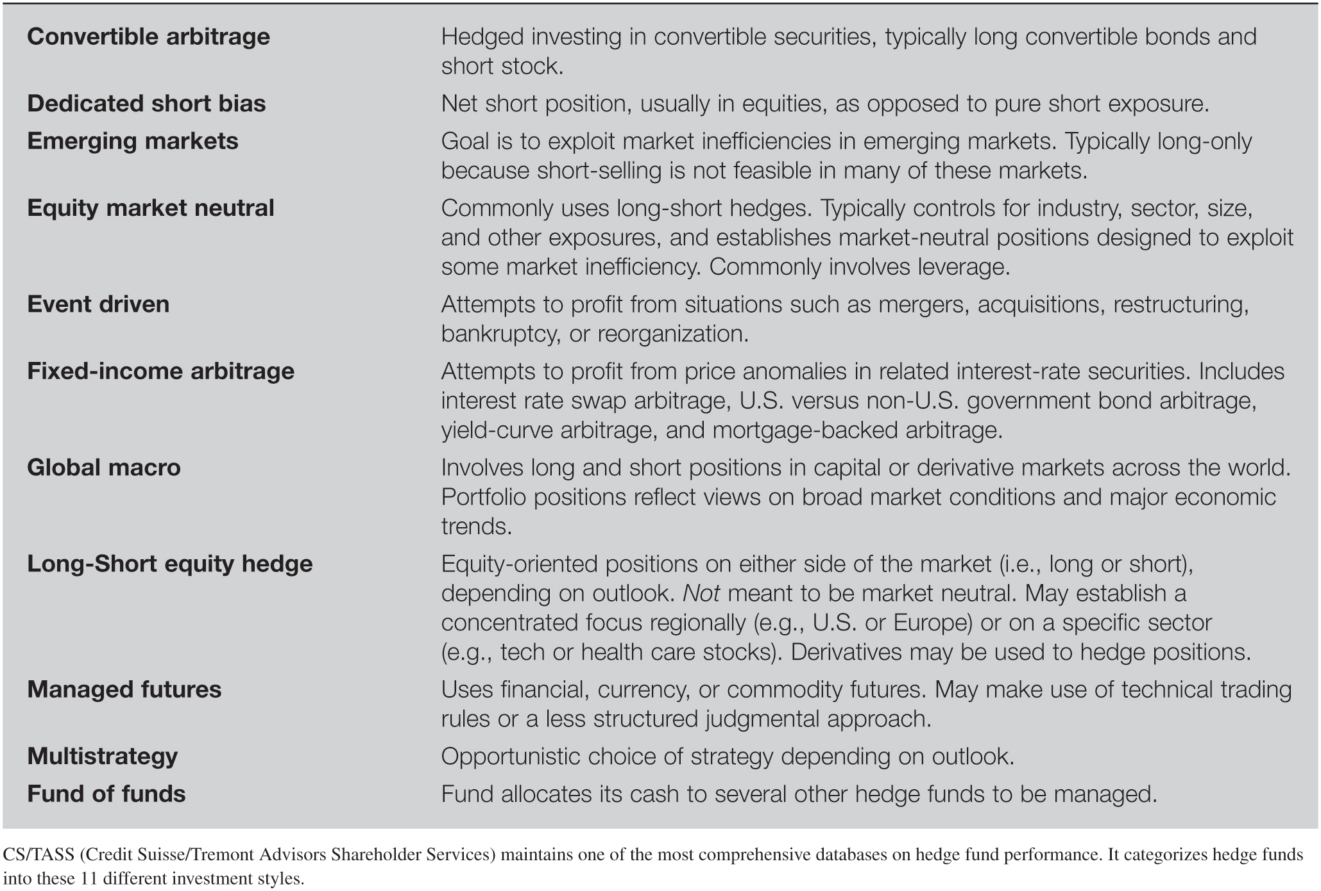
Hedge Fund Styles
Notes:
Convertible bond arbitrage: If the fund thinks the convertible is underpriced you buy the convertible and short the stock. Wait for the mispricing to be fixed.

Slide 30
Fee Structure in Hedge Funds

Slide 31
Evaluating Hedge Fund Fees
Typical hedge fund fees includes a fixed management fee between 1% and 2% of assets plus an incentive fee usually equal to 20% or more of investment profits above a benchmark performance return.
Incentive fees are analogous to call options on the portfolio with a strike price equal to the current portfolio value x (1+ benchmark return).
Top performing hedge funds 2015
Top earning hedge fund managers

Slide 32
The $50 Billion Madoff Scandal
Madoff operated a $50 billion Ponzi Scheme
In a Ponzi scheme the con artist (Madoff) promises and initially pays high returns to investors. The large returns are generated by paying out to old clients some of the money paid in by new clients.
The con also skims some of the money for his or her own purposes. The scheme can work for some time until the fund stops growing.
Madoff was a respected individual, former chairman of NASDAQ with prestigious client book.
Notes:
His firm was Bernard L. Madoff Investment Securities LLC. The firm reported earnings of between 10% and 12% in good markets and bad.
Madoff apparently operated his scheme for more than eight years.
Fairfield Greenwich Advisors had exposure of $7.5 billion, other funds with exposure over $ 1 billion included Tremont Group Holdings, Banco Santander, Ascot Partners and Access International Advisors.

Slide 33
The $50 Billion Madoff Scandal
In 2008 redemptions began as clients needed money, scheme unwound.
Lack of reporting requirements made the fraud possible but there were several warning signs:
Returns were too stable for too long,
Fund fee structure was too generous,
Audit firm was not a major auditor,
All assets were kept in house rather than with a custodian,
No evidence of option investments Madoff claimed to be making,
SEC received a letter in 2000 stating that the fund was a Ponzi scheme.
Madoff scandal short video
Notes:
His firm was Bernard L. Madoff Investment Securities LLC. The firm reported earnings of between 10% and 12% in good markets and bad.
The auditor was three people, one of which was an accountant.
Madoff apparently operated his scheme for more than eight years.
Fairfield Greenwich Advisors had exposure of $7.5 billion, other funds with exposure over $ 1 billion included Tremont Group Holdings, Banco Santander, Ascot Partners and Access International Advisors.

Slide 34
Thank you for the attention!
Any Questions?

